Slide 1
MAE 263F Final Presentation
Soft Robotic Stabilization in Ocean Currents

Slide 2
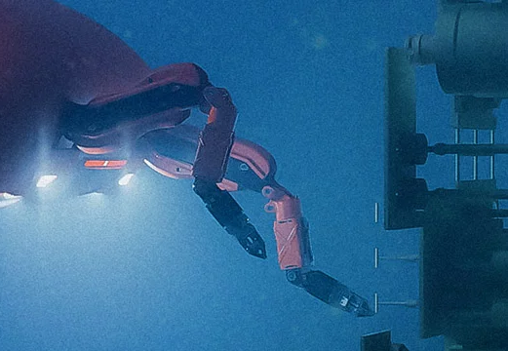
Motivation
Sample collection for underwater ecological research
Submersible vehicles are equipped with robot arms to collect samples from reefs
Rigid robots risk damaging the surrounding environment
Image Source

Slide 3
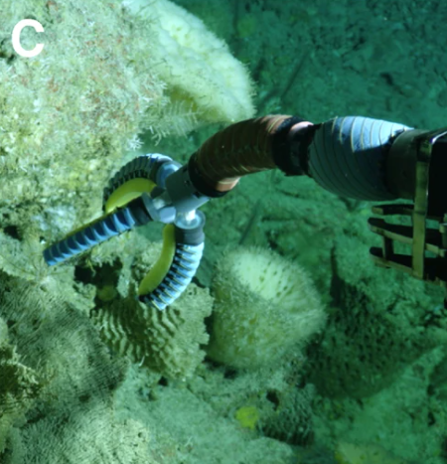
Motivation
Soft robotics’ flexibility better fit interaction with delicate coral reefs
However, they are more susceptible to current fluctuations, which limit their functionality
Can an algorithm be created to improve the control of soft robotic arms in changing currents?
Image Source

Slide 4
Related Works
Planar inverted pendulum stabilization with hybrid controller
Controller for upward stability
Controller for recovering from downed position
Eel-like underwater locomotion
2D fluid model for simulation

Slide 5
Related Works
Pneumatic and hydraulic actuation of underwater soft robotic arms
Definition of feasible control schemes for the arm
Neural ODE Controller for Deformable Linear Objects
Possible Control scheme for future developments

Slide 6
Simulation Setup
High Reynolds Number Fluid Simulation of Planar DER
Prismatic Y-Coordinate Control with a PID controller
Steady Background flow with swells varying magnitude and direction

Slide 7
Approach
Define a steady control scheme for one swell magnitude and direction
Vary the direction of the swell to determine controller feasibility
  Aiming to find symmetric responses
Vary the magnitude of the swell to determine controller feasibility
  Aiming to find limits for the PID Controller

Slide 8
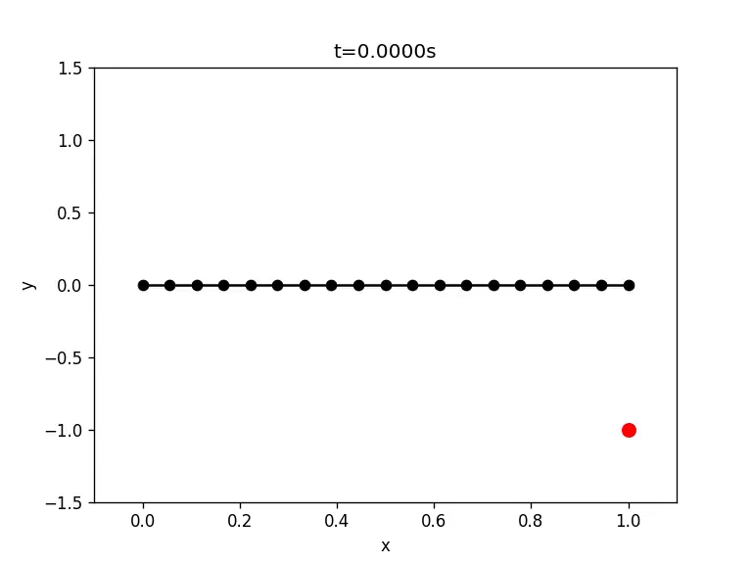
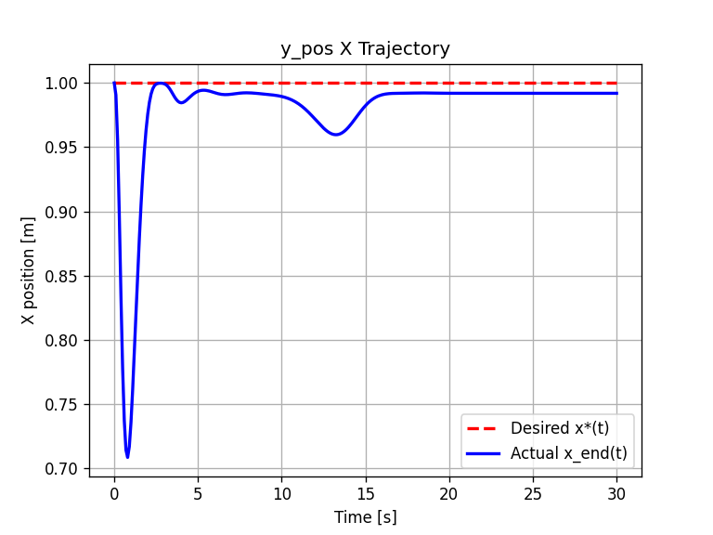
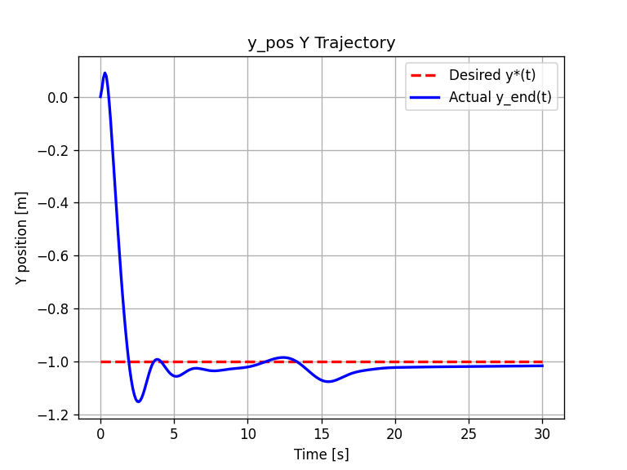

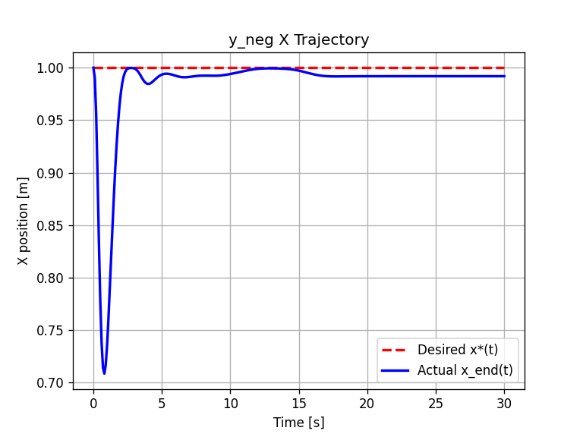
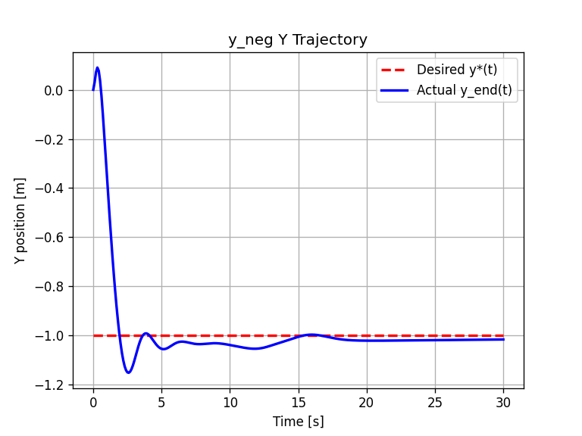
Results - Direction Changes (Vertical)

Slide 9
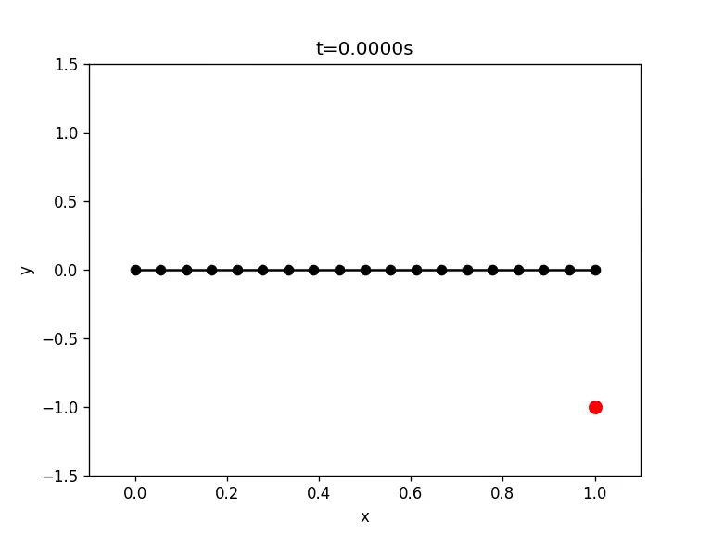

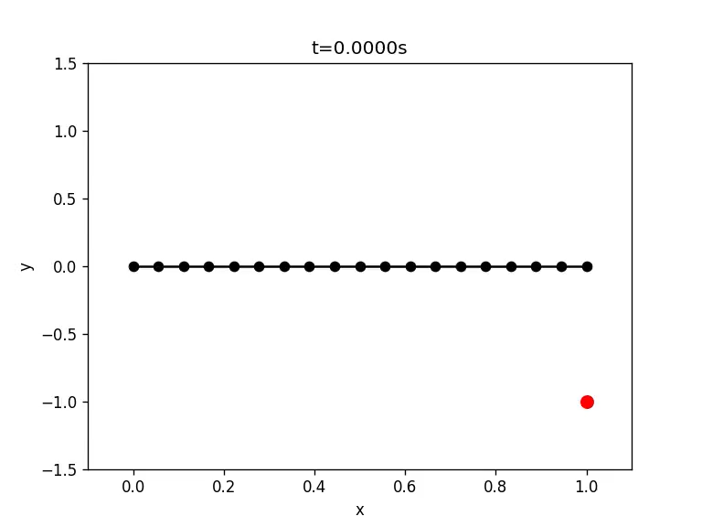


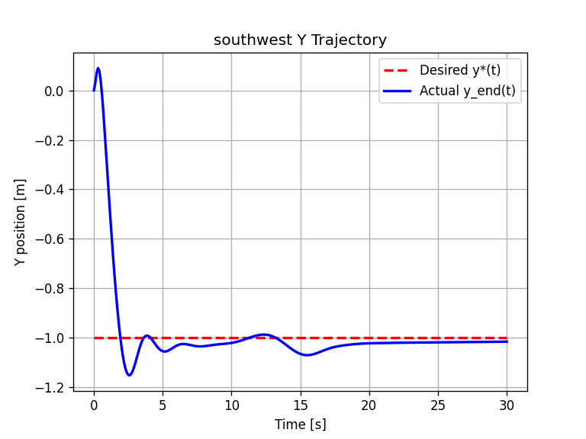


Results - Direction Changes (Cartesian Directions)

Slide 10
Results - Direction Changes
East-West Symmetry
North-South Asymmetry
Potentially due to the default background flow
Response is stable

Slide 11
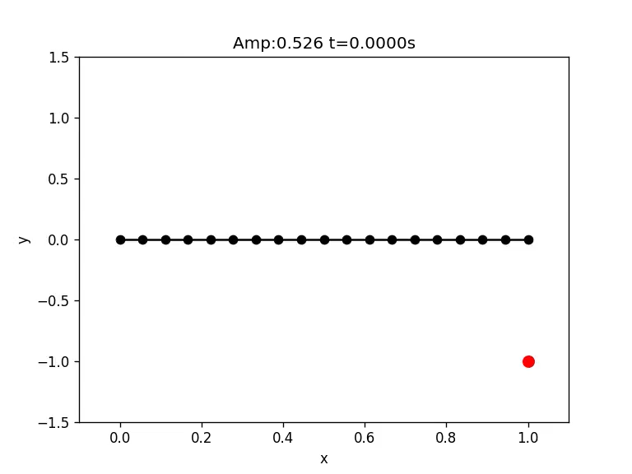
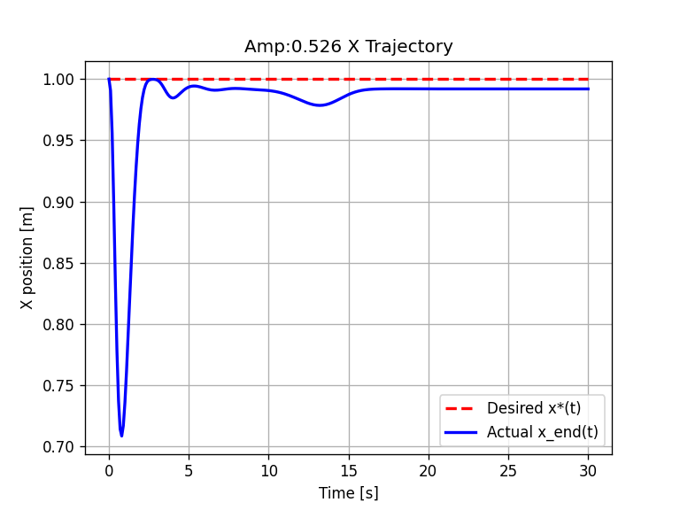
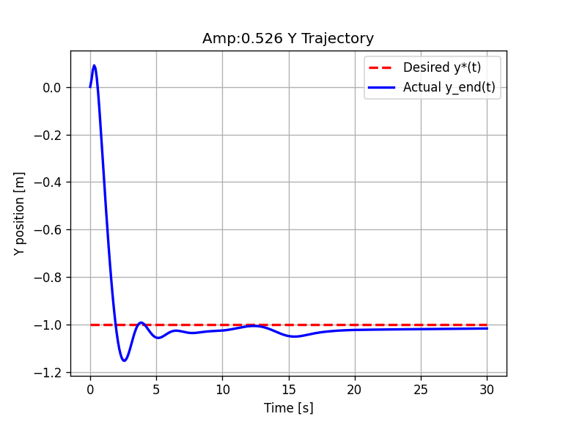

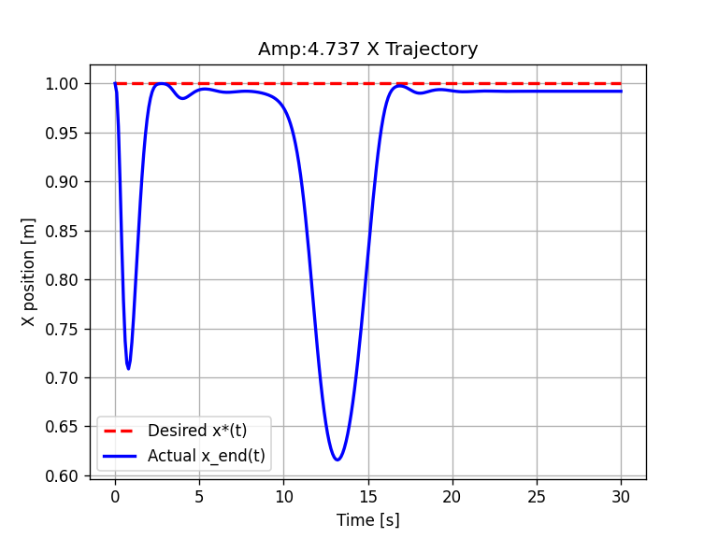
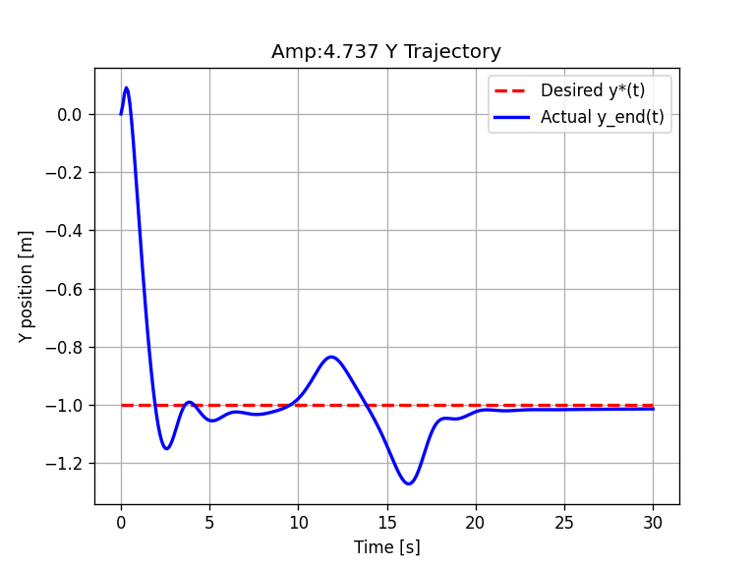
Results - Magnitude Changes

Slide 12
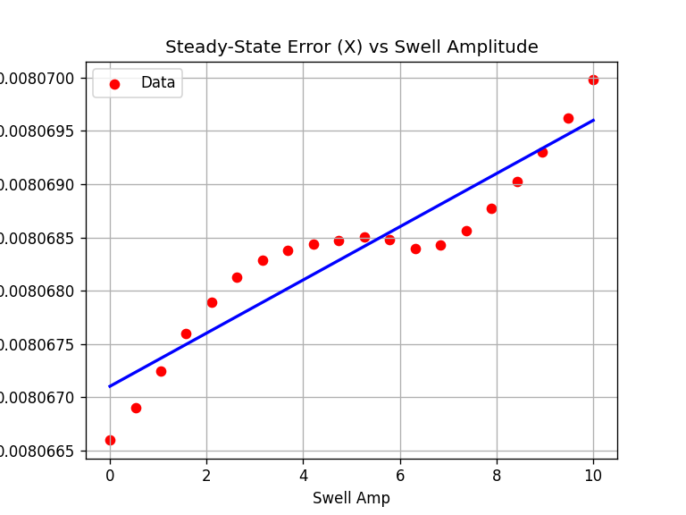
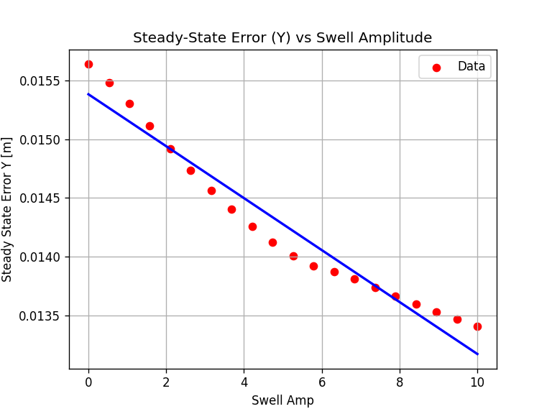
Results - Magnitude Changes

Slide 13
Future Works
Test the asymmetry in the North-South flow response
Add a controller for the X-direction
Solve the challenges presented moving the simulation into 3D, primarily fluids

